Slide 1

BOOK
RECOMMENDATION SYSTEM
Generate the features from the dataset and use them to
recommend the books according to the users
Respondents:Group 6
Instructor:Advaith

Slide 2
CONTENT
Problem Statement
Project Architecture
Introduction to Recommendation System
Dataset Overview
Data Preprocessing
EDA(Exploratory data analysis)
Visualization
Recommendation Techniques
Model Building
Deployment
Conclusion

Slide 3
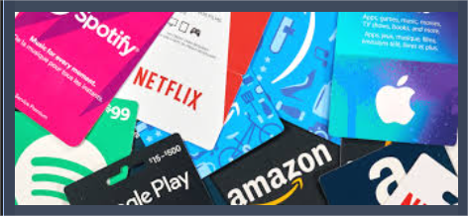

Problem Statement:
The main objective of our project is to create Book Recommender System aims to simplify the book discovery process, assist users in finding books that align with their interests, and ultimately enhance the overall reading experience for individuals of diverse tastes and preferences. .
Netflix uses a recommendation system to present viewers with movie and show suggestions. Amazon, on the other hand, uses a recommendation system to present customers with product recommendations. While each use one for slightly different purposes, both have the same goal to drive sales, boost engagement and retention, and deliver more personalized customer experiences.

Slide 4
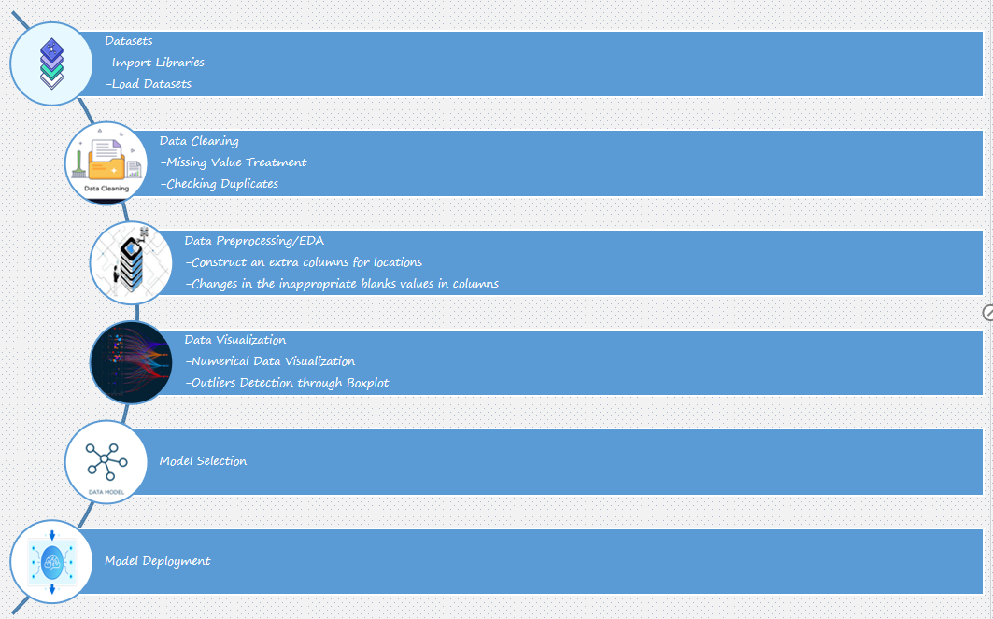
Project Architecture:

Slide 5

Introduction to Recommendation System:
Recommendation systems involve predicting user preferences for unseen items.
Recommendation systems have become popular with the increasing availability of millions of products online.
Recommending relevant products increases the customers interest and the sales of the company.
Examples-
Facebook- ‘People You May Know’
Netflix- ‘Other Movies You May Enjoy’
Amazon- ‘Customers Who brought this item’
And So on…

Slide 6
Dataset Overview:
BOOKS
USERS
ISBN: The International Standard Book Number is a unique numeric Identifier
Book-Title: Title of Book corresponding to an ISBN
Book-Author: Author of the book
Year-Of-Publication: Year of Publication of the book
Publisher: Publisher of the book
Image-URL-S: Small cover image url to a book
Image-URL-M: Medium cover image url to a book
Image-URL-L: Large cover image url to a book
RATINGS
User-ID: Unique ID of each user
ISBN: The International Standard Book Number is a unique numeric Identifier
Book-Rating: Book-Rating are either explicit, expressed on a scale from 1-10
(higher values denoting higher appreciation), or implicit, expressed by 0.
User-ID: Unique ID of each user
Location: Location of the user
Age: Age of the user

Slide 7
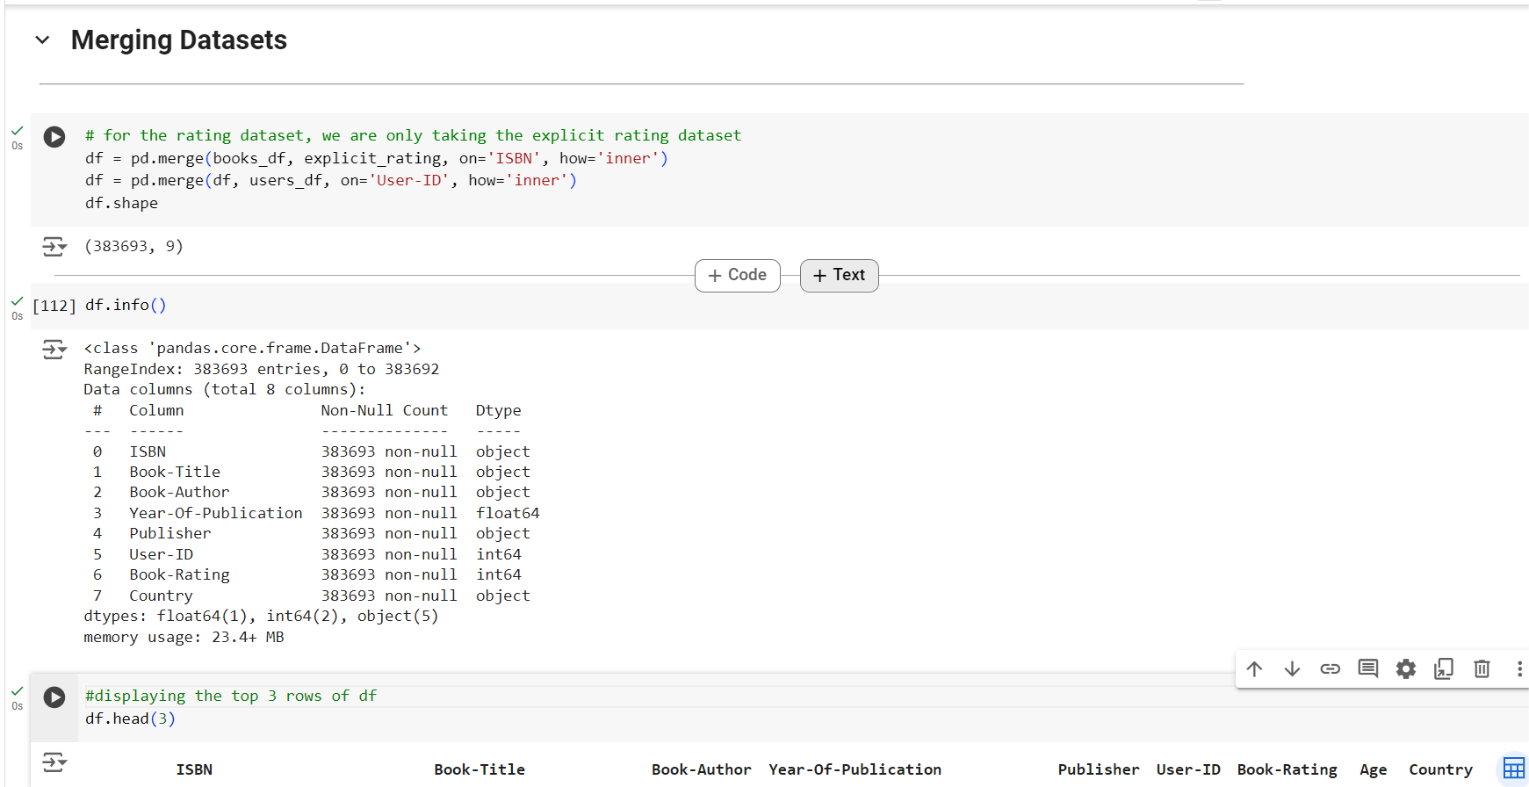
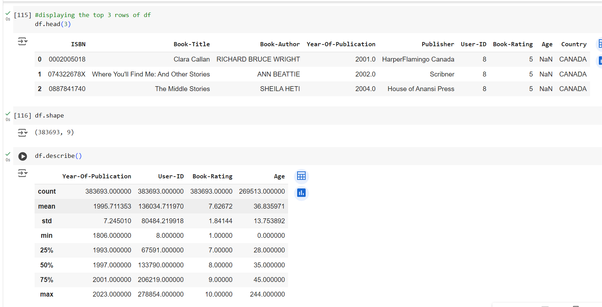
Merged Dataset:
Have merged the Datasets that contains data of Books, Users and Rating dataset.
By removing the missing values and duplicates from the above datasets we have mergerd these datasets and will be performing data visulisation and EDA.
As we have this information that books and users dataset have many missing values and duplicates
Where as rating dataset has clean data in it’s dataset.
And here we have conveyed the information regarding the merged dataset process

Slide 8
Data Visulisation and EDA (Exploratory data analysis)
The main objective of our project is to create Book Recommender System aims to simplify the book discovery process, assist users in finding books that align with their interests, and ultimately enhance the overall reading
experience for individuals of diverse tastes and preferences. .
So we are showing the outputs of the Merged dataset by performing data EDA using data visulisation techniques.

Slide 9
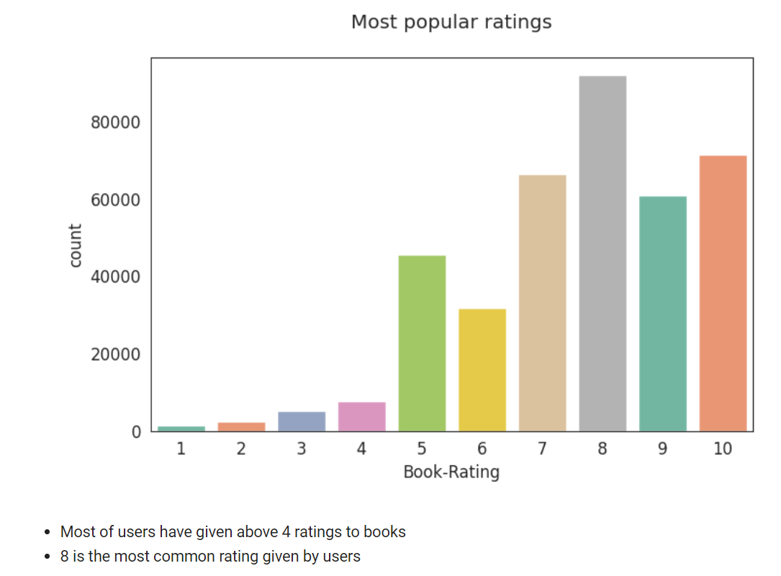
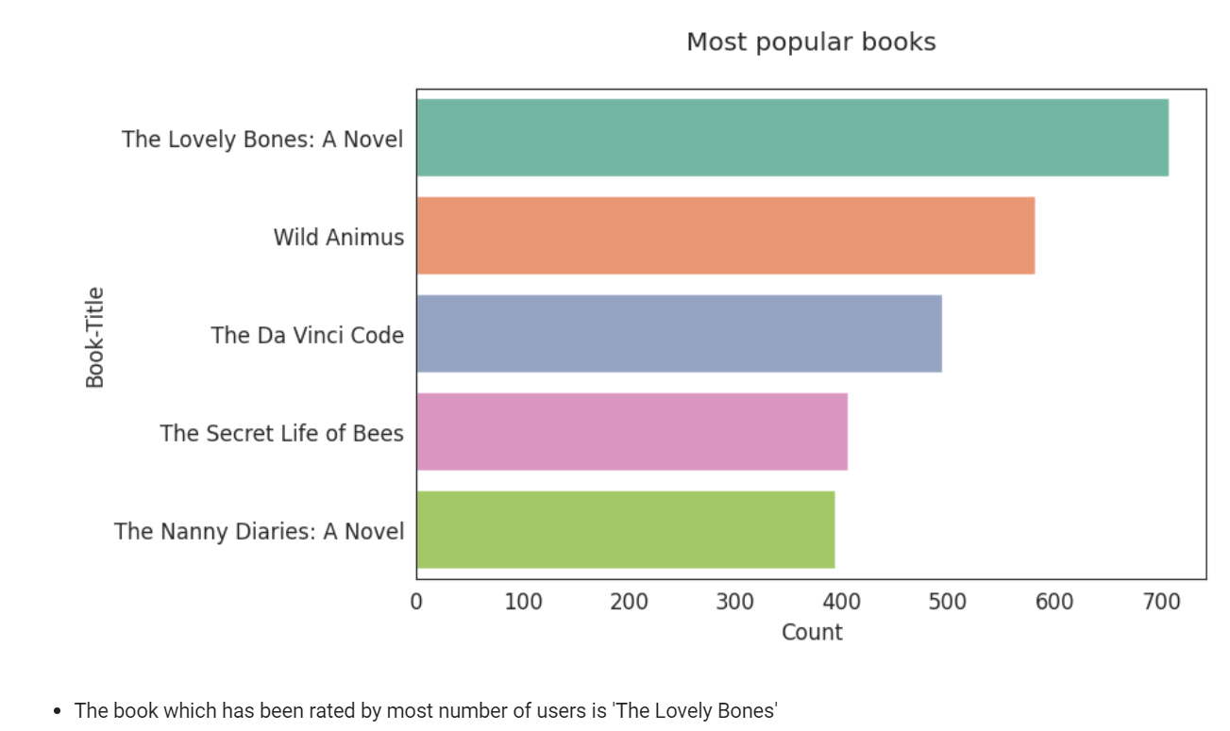
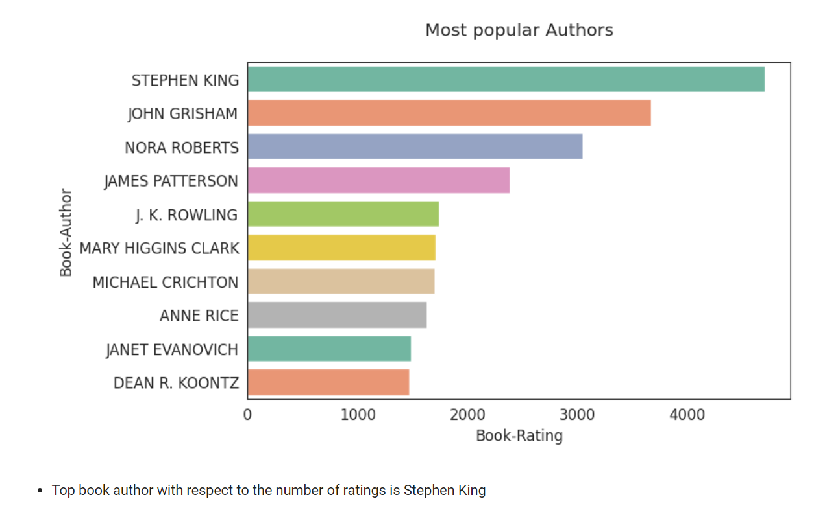
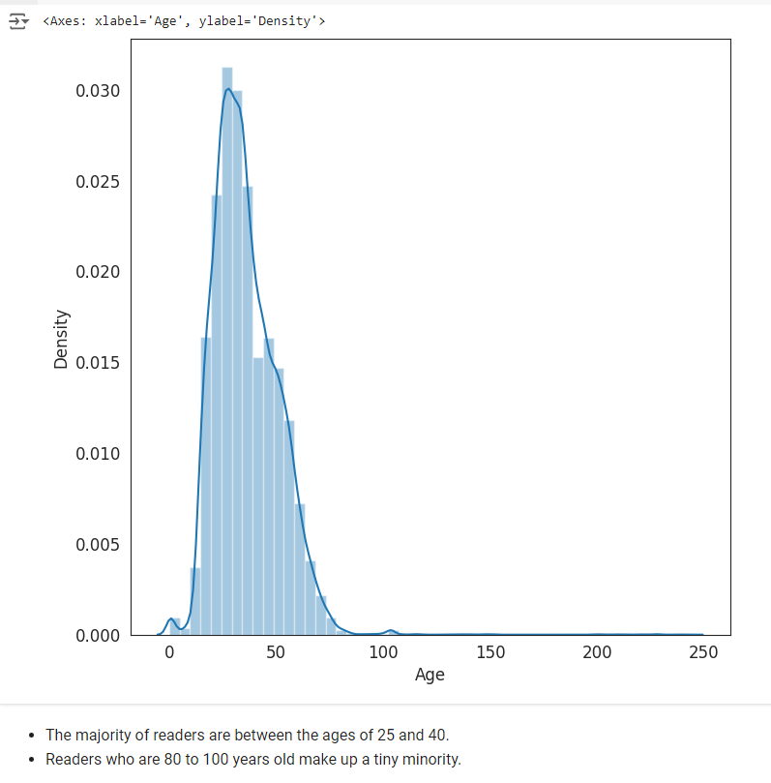
EDA Outputs:
01
Results of most popular ratings
02
Results of top 5 book ratings
03
Ratings of top book authors
04
Age distribution of users

Slide 10
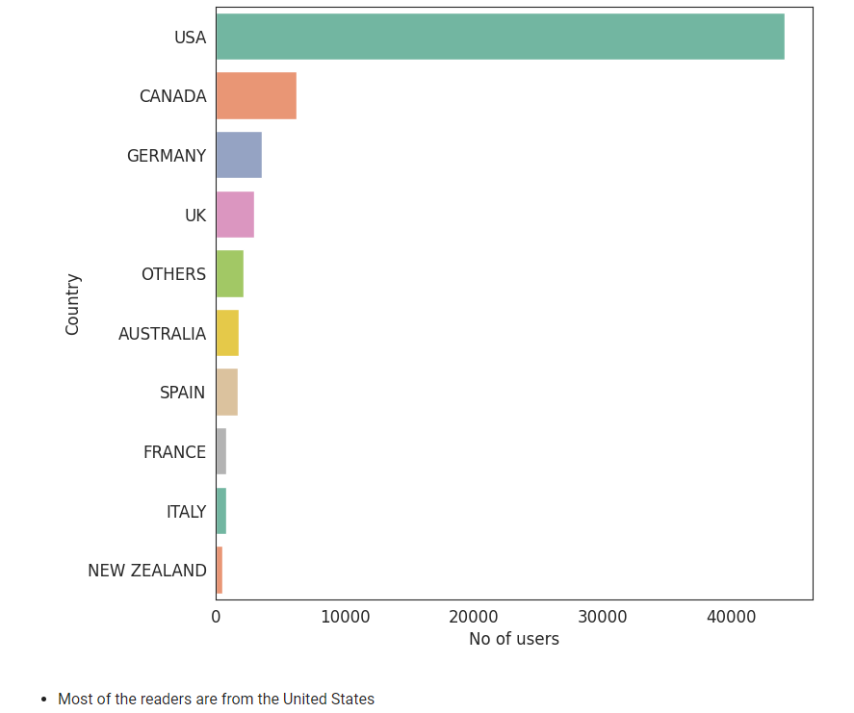
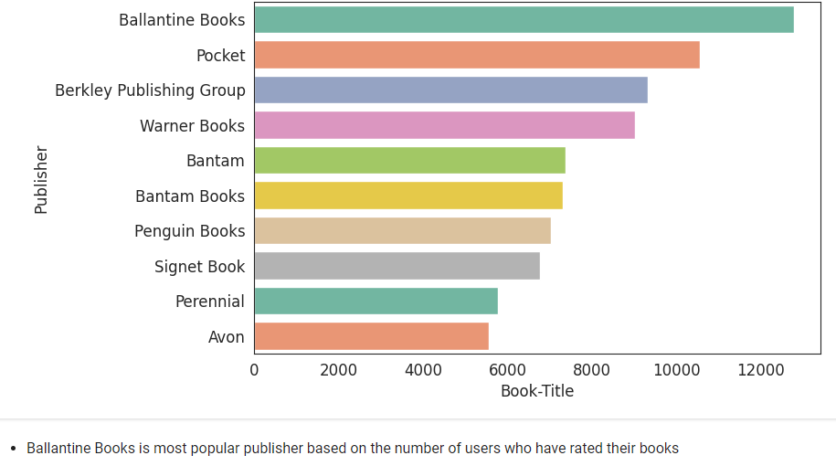
Continue.....
06
05
Results of top 5 book ratings
Results of most popular ratings
EDA CONCLUSIONS:
.The Lovely Bones: A Novel and Wild Animus are the two most read books.
.Most popular book author based on the number of ratings is Stephan King .
.Ballantine Books and Pocket are the top publishers based on the number of ratings that their books have received.
.The majority of readers are between the ages of 20 and 40.
.The majority of readers who have given the books ratings are from the United States and Canada.

Slide 11
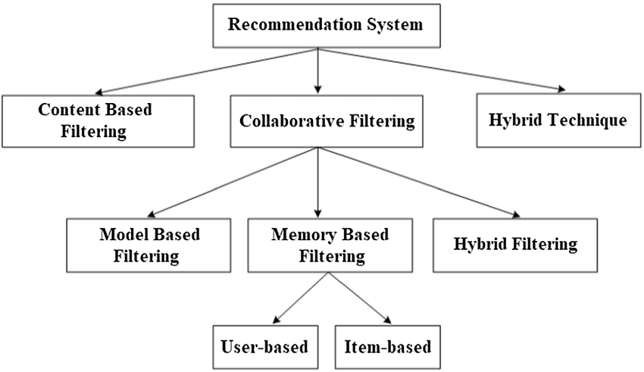
Recommendation Techniques

Slide 12
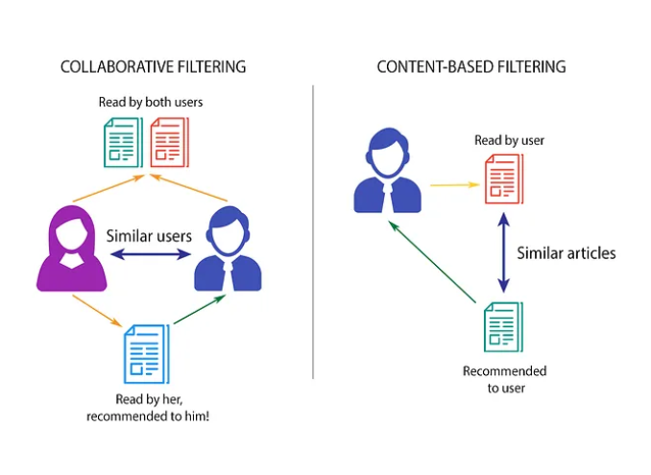
Content-Based Filtering
This filtering is based on the description or some data provided for that product. The system finds the similarity between products based on its context or description. The user’s previous history is taken into account to find similar products the user may like.
For example, if a user likes movies such as ‘Mission Impossible’ then we can recommend him the movies of ‘Tom Cruise’ or movies with the genre ‘Action’.
Advantages
The user gets recommended the types of items they love.
The user is satisfied by the type of recommendation.
New items can be recommended; just data for that item is required.
Disadvantages
The user will never be recommended for different items.
Business cannot be expanded as the user does not try a different type of product.
If the user matrix or item matrix is changed the cosine similarity matrix needs to be calculated again.

Slide 13
Collaborative Filtering
The recommendations are done based on the user’s behavior.
Two types of collaborative filtering techniques are used:
User-User collaborative filtering - used to search for other users with similar tastes and recommend the items those users like the most.
Item-Item collaborative filtering - based on the similarity between items calculated using people’s ratings of those items
Advantages
New products can be introduced to the user.
Business can be expanded and can popularise new products.
Disadvantages
User’s previous history is required or data for products is required based on the type of collaborative method used.
The new item cannot be recommended if no user has purchased or rated it.

Slide 14
Model Building
Model building is the process of creating a mathematical model that can be used to predict or explain a real-world phenomenon. The model is built using data that has been collected about the phenomenon, and it is then used to make predictions or explanations about new data..

Slide 15
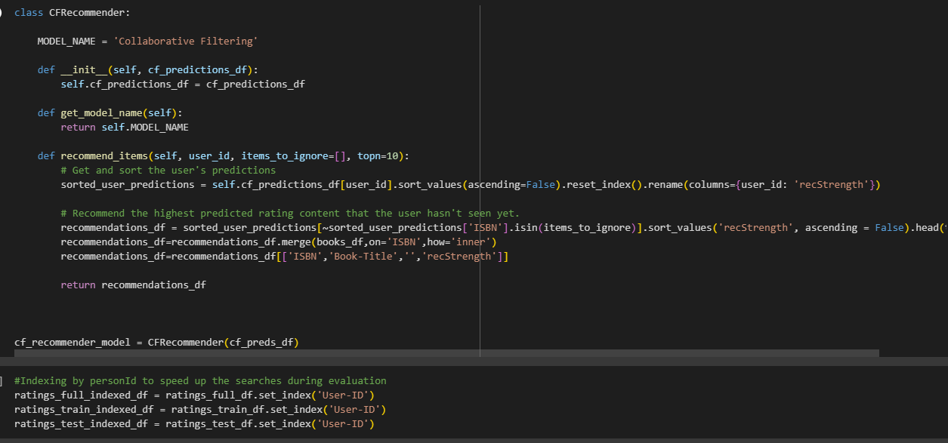
Model Building
Chose user-based collaborative filtering model.
Approach:
1.Filter out users with atleast 100 interaction.
2.Create user-item matrix(pivot-table)
3.Calculate similarity between users.
4.recommend book based upon user similarity.

Slide 16
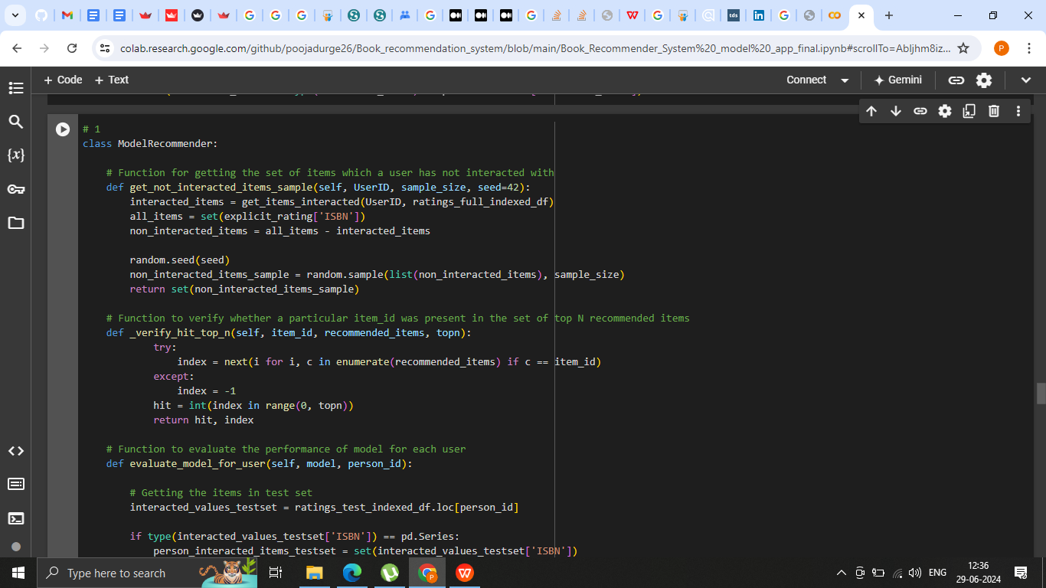
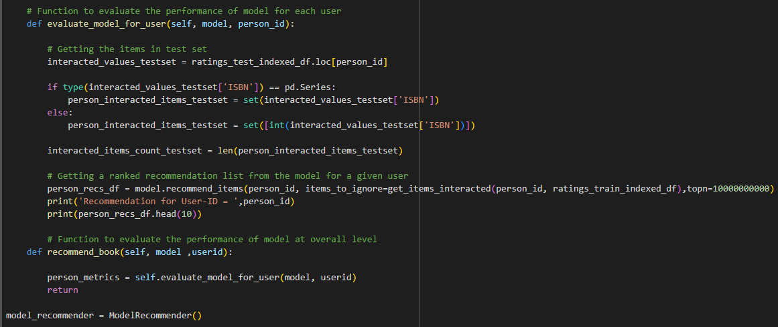
Model Building continue..:

Slide 17
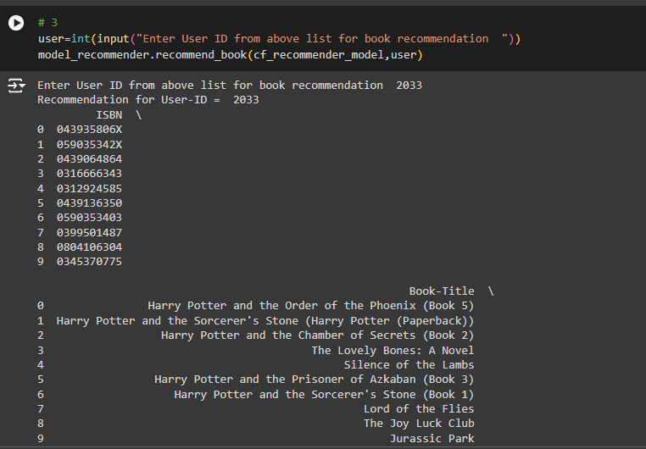

Slide 18
Model Evaluation
Model evaluation is the process that uses some metrics which help us to analyze the performance of the model. As we all know that model development is a multi-step process and a check should be kept on how well the model generalizes future predictions.

Slide 19
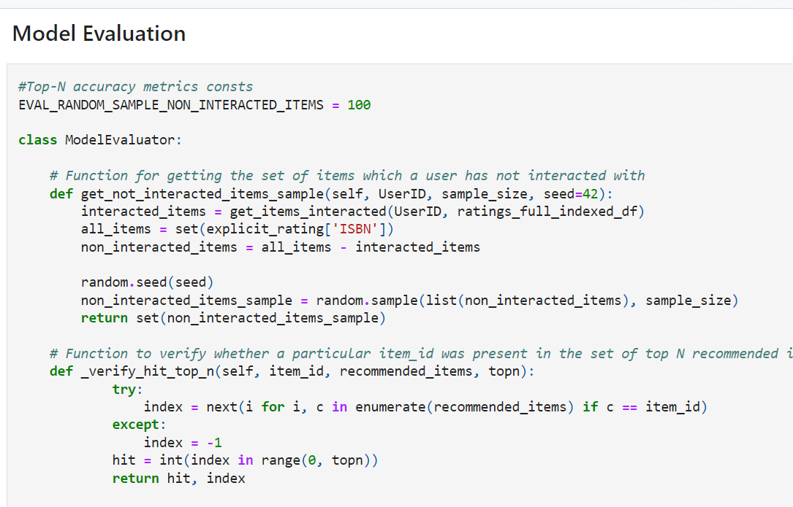
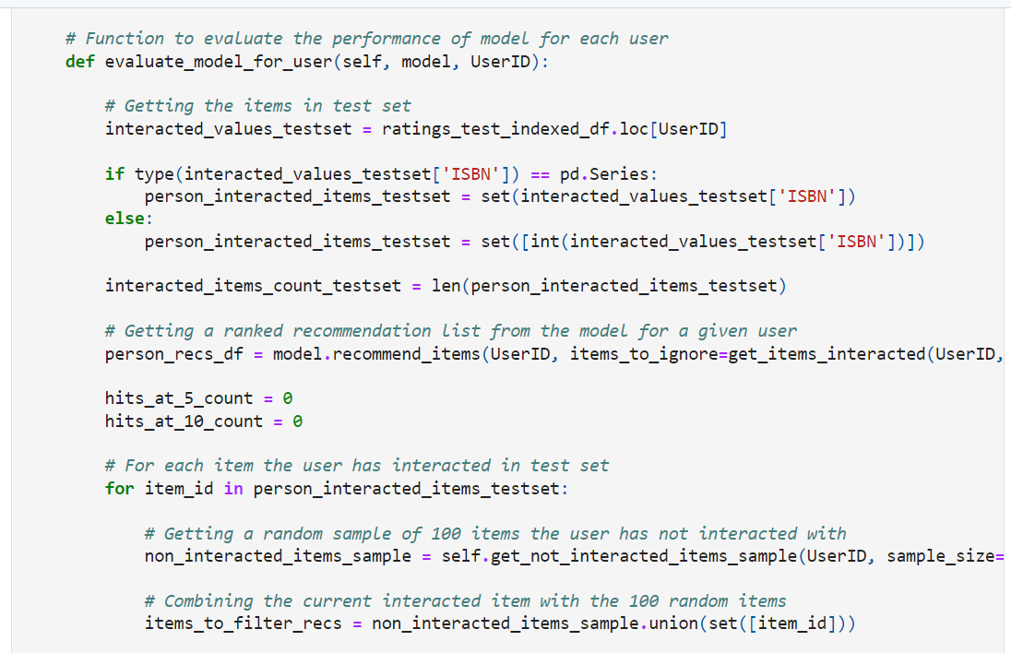
Model Evaluation:
.After training, it’s crucial to assess how well your model performs on unseen data. Evaluation metrics help you measure accuracy, precision, recall, and more

Slide 20
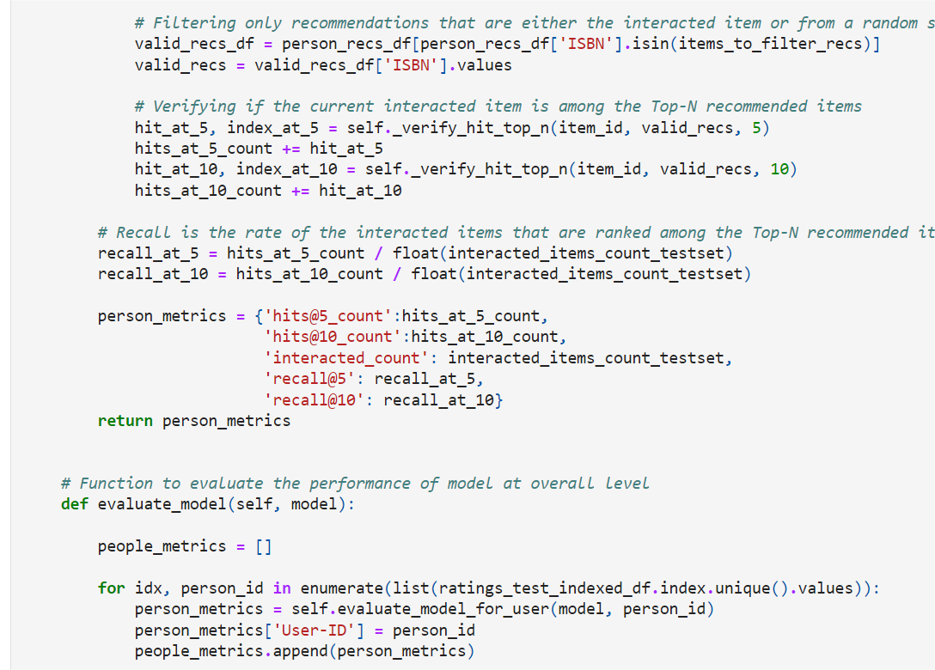
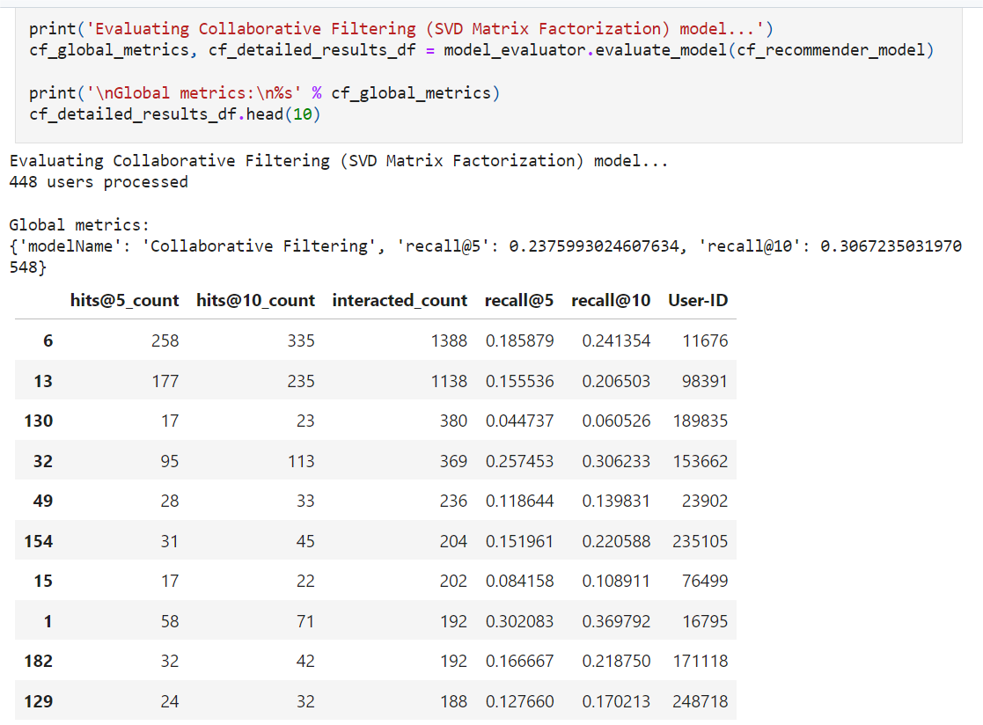
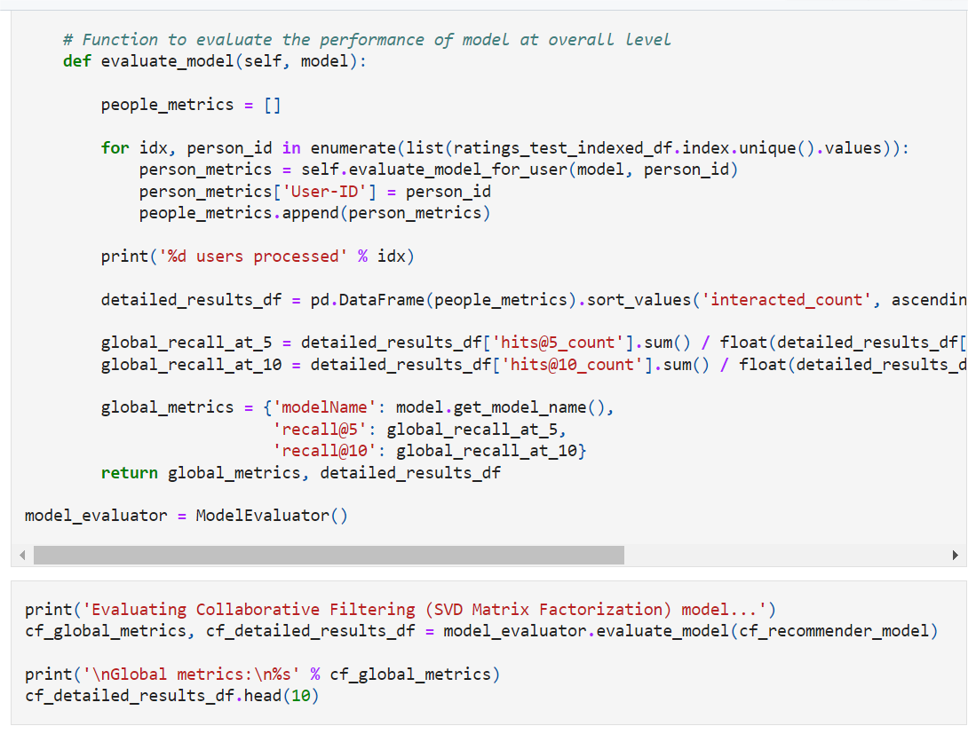
Evaluation outputs:
Recall@5 of 24%
Recall@10 of 31%

Slide 21
Model Deployment
In machine learning, model deployment is the process of integrating a machine learning model into an existing production environment where it can take in an input and return an output.

Slide 22
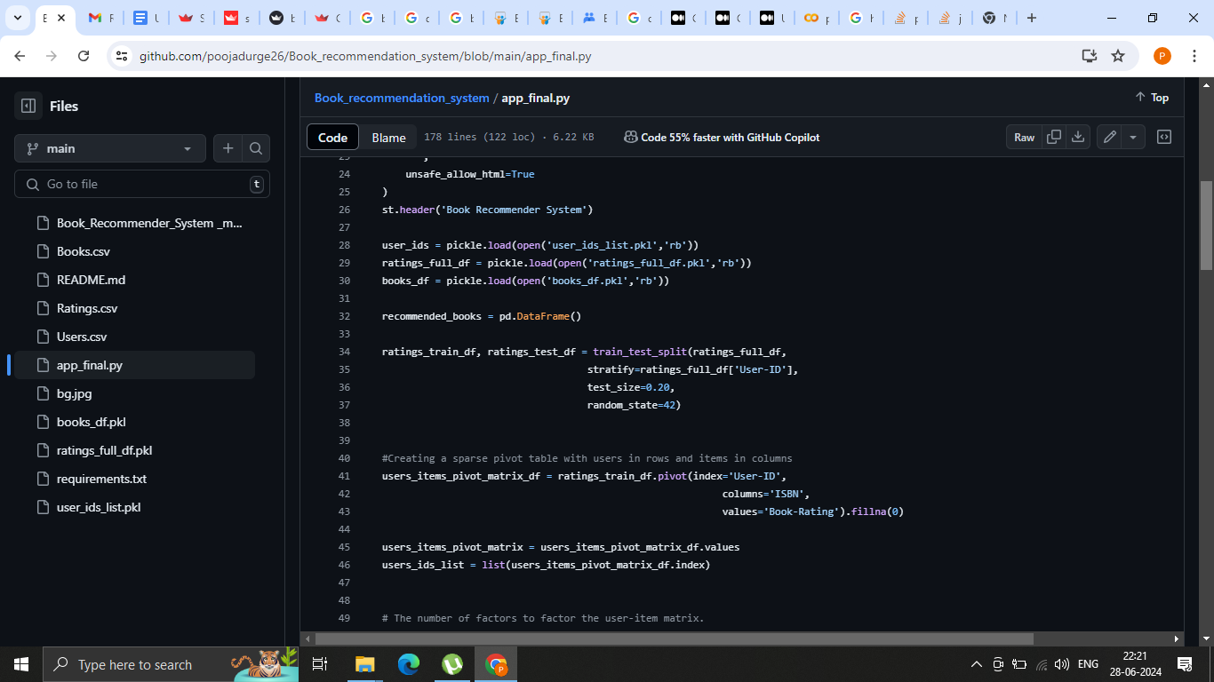
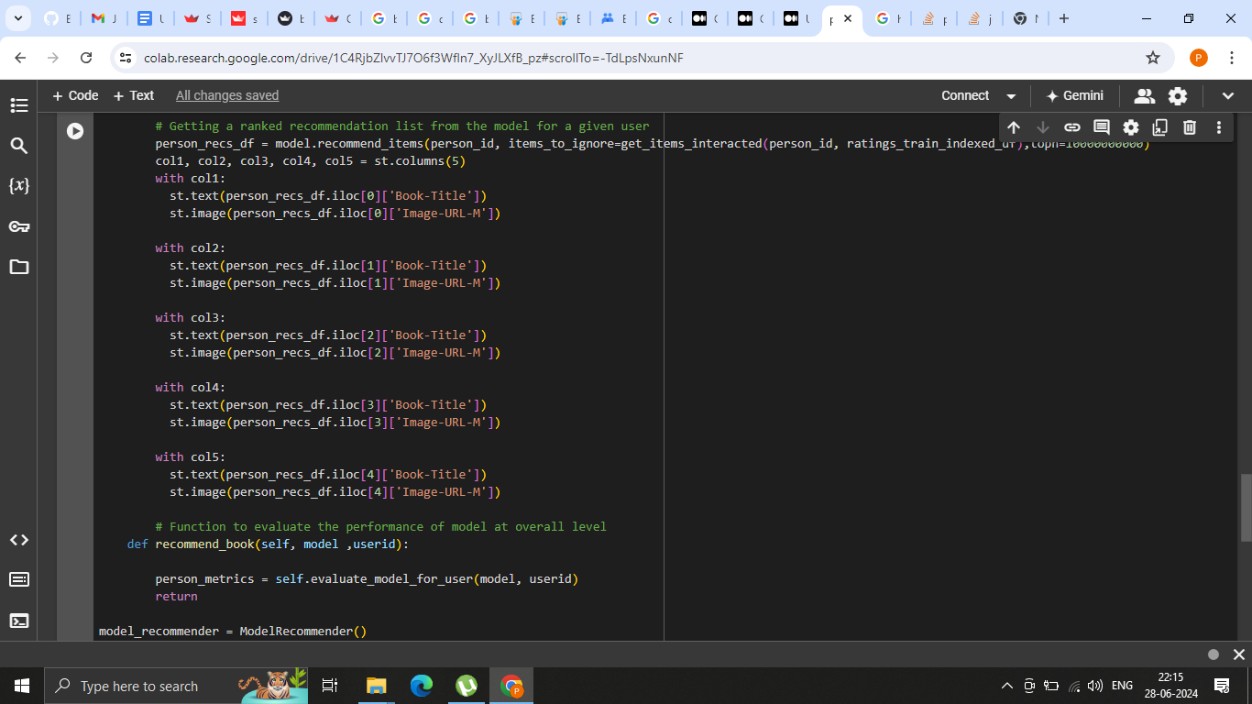
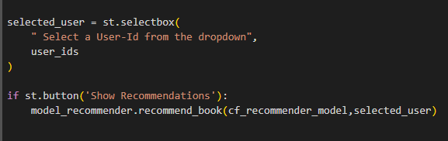
Model deployment:
Used Streamlit and Github.
Setting Header and importing pickles
Setting book Title and cover image
Setting user-id selection box and recommendation button

Slide 23
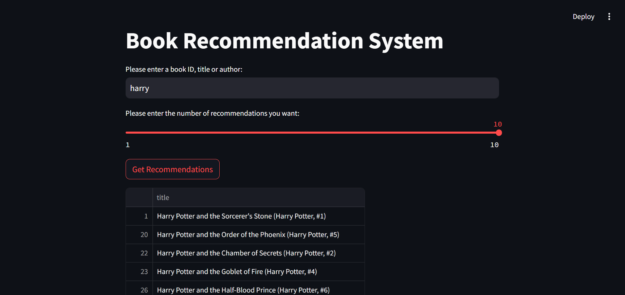
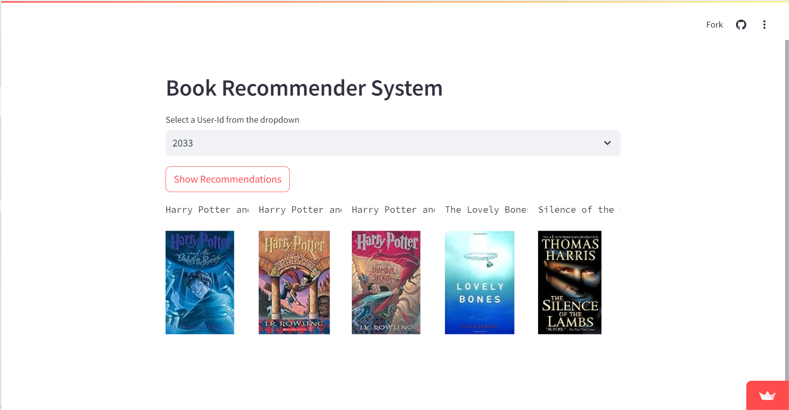
Output of the Web Application:

Slide 24
Conclusion
Here we are discussing and describing future improvements and business value, Challenges and Recommendation system and Case Study Overview of the Above performed models Data

Slide 25
Conclusion:
The initial step, of our project was Data preprocessing of the three datasets-books_df, users_df and ratings_df, wherein we removed duplicates and imputed the missing values & invalid entries with appropriate values and corrected spellings .
Then, we used user-based Collaborative filtering approach to build recommendation model.
We evaluated the performance of Singular Value Decomposition based
recommender and obtained a Global Recall@5 of 24% and Recall@10 of
31%.
Then Deployed model using Streamlit and Github.

Slide 26


Future Improvements and Business Value:
Potential Improvements
Develop hybrid recommendation systems combining collaborative and content-based filtering
Integrate deep learning techniques for better feature extraction and recommendation accuracy
Enhance user feedback loops to continuously improve the recommendation model
Utilize real-time data processing for more dynamic and timely recommendations
Business Value
Increased user engagement and satisfaction through personalized recommendations
Higher sales and conversion rates due to better-targeted product suggestions
Improved customer retention by anticipating user needs and preferences
Valuable insights into consumer behavior to inform marketing strategies

Slide 27
THANKS
This is our working model of Recommendation System and the needed outputs are also displayed...

